Slide 1

Using the COM Interface
Roger C. Dugan
Sr. Technical Executive, EPRI
Jacobs Hall, UCSD
Dec 14-15, 2010

Slide 2
Active objects concept
There is one registered In-Process COM interface:
  OpenDSSEngine.DSS
    That is, the DSS interface is the one you instantiate
    The DSS interface creates all the others.
The interfaces generally employ the idea of an
ACTIVE object
  Active circuit,
  Active circuit element,
  Active bus, etc.
  The interfaces generally point to the active object
    To work with another object, change the active object.

Slide 3
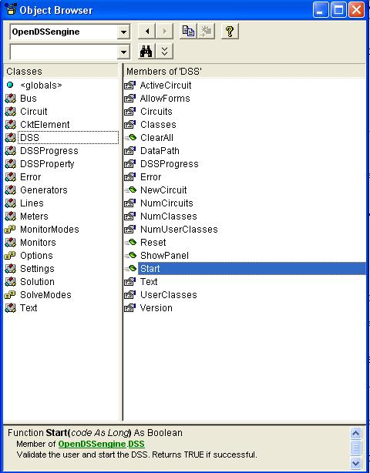
DSS Interface
This interface is instantiated upon loading OpenDSSEngine.DSS and then instantiates all other interfaces
Call the Start(0) method to initialize the DSS
DSS Class Functions (methods) and Properties

Slide 4
Instantiate the DSS Interface and Attempt Start
Public Sub StartDSS()
' Create a new instance of the DSS
Set DSSobj = New OpenDSSengine.DSS
' Start the DSS
If Not DSSobj.Start(0) Then
MsgBox "DSS Failed to Start"
Else
MsgBox "DSS Started successfully“
' Assign a variable to the Text interface for easier access
Set DSSText = DSSobj.Text
End If
End Sub

Slide 5
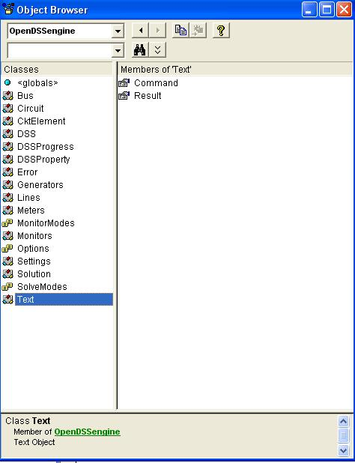
COM Interface
Interfaces as Exposed by VBA Object Browser in MS Excel
Text interface is simplest
Text has two Properties

Slide 6
Assign a Variable to the Text Interface
Public Sub StartDSS()
' Create a new instance of the DSS
Set DSSobj = New OpenDSSengine.DSS
' Start the DSS
If Not DSSobj.Start(0) Then
MsgBox "DSS Failed to Start"
Else
MsgBox "DSS Started successfully“
' Assign a variable to the Text interface for easier access
Set DSSText = DSSobj.Text
End If
End Sub

Slide 7
Now Use the Text Interface …
You can issue any of the DSS script commands from the Text interface
‘ Always a good idea to clear the DSS when loading a new circuit
DSSText.Command = "clear"
' Compile the script in the file listed under "fname" cell on the main form
DSSText.Command = "compile " + fname
‘ Set regulator tap change limits for IEEE 123 bus test case
With DSSText
.Command = "RegControl.creg1a.maxtapchange=1 Delay=15 !Allow only one tap change per solution. This one moves first"
.Command = "RegControl.creg2a.maxtapchange=1 Delay=30 !Allow only one tap change per solution"
.Command = "RegControl.creg3a.maxtapchange=1 Delay=30 !Allow only one tap change per solution"
.Command = "RegControl.creg4a.maxtapchange=1 Delay=30 !Allow only one tap change per solution"
.Command = "RegControl.creg3c.maxtapchange=1 Delay=30 !Allow only one tap change per solution"
.Command = "RegControl.creg4b.maxtapchange=1 Delay=30 !Allow only one tap change per solution"
.Command = "RegControl.creg4c.maxtapchange=1 Delay=30 !Allow only one tap change per solution"
.Command = "Set MaxControlIter=30"
End With

Slide 8
Result Property
The Result property is a Read Only property that contains any result messages the most recent command may have issued.
  Error messages
  Requested values
‘ Example: Query line length
DSSText.Command = “? Line.L1.Length”
S = DSSText.Result ‘ Get the answer
MsgBox S ‘ Display the answer

Slide 9
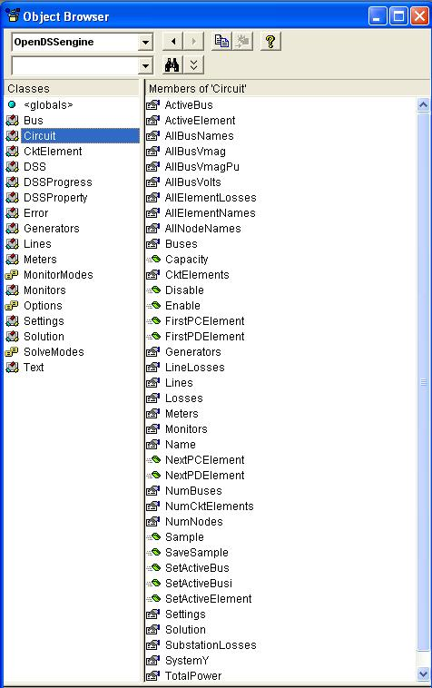
Circuit Interface
This interface is used to
Get many of the results for the most recent solution of the circuit
Select individual circuit elements in a variety of ways
Select the active bus
Enable/Disable circuit elements

Slide 10
Circuit Interface
Since the Circuit interface is used often, it is recommended that a special variable be assigned to it:
Public DSSCircuit As OpenDSSengine.Circuit
…
DSSText.Command = “Compile xxxx.dss”
Set DSSCircuit = DSSobj.ActiveCircuit
DSSCircuit.Solution.Solve
… ‘ Retrieving array quantities into variants
V = DSSCircuit.AllBusVmagPu
VL =DSSCircuit.AllElementLosses

Slide 11
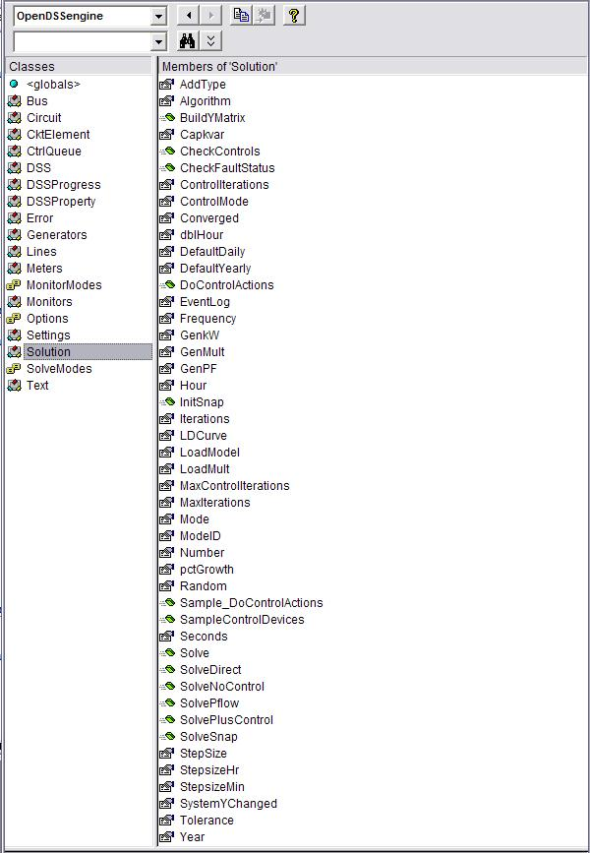
Solution Interface
The Solution Interface is used to
Execute a solution
Set the solution mode
Set solution parameters (iterations,
control iterations, etc.)
Set the time and time step size

Slide 12
Solution Interface
Assuming the existence of a DSSCircuit variable referencing the Circuit interface
Set DSSSolution = DSSCircuit.Solution
With DSSSolution
…
.LoadModel=dssAdmittance
.dblHour = 750.75
.solve
End With
Use the With statement in VBA to simplify coding

Slide 13
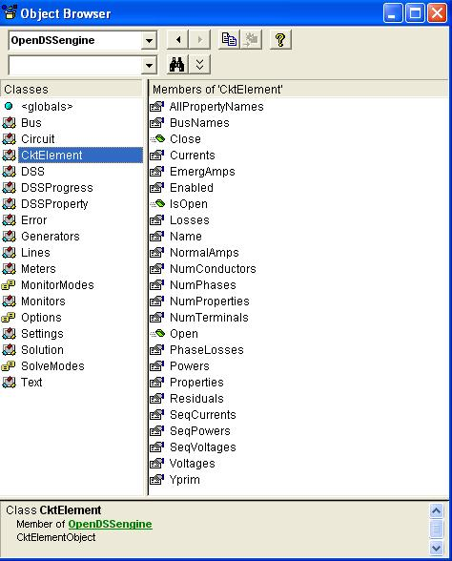
CktElement Interface
This interface provides specific values of the Active Circuit Element
Some values are returned as variant arrays
V = DSSCircuit.ActiveElement.Powers
V = DSSCircuit.ActiveElement.seqCurrents
V = DSSCircuit.ActiveElement.Yprim
Other values are scalars
Name = DSSCircuit.ActiveElement.Name
Nph = DSSCircuit.ActiveElement.NumPhases

Slide 14
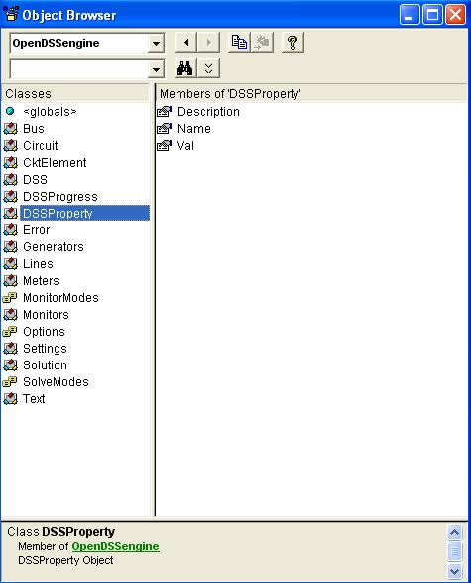
Properties Interface
This interface gives access to a String value of each public property of the active element
“Val” is a read/write property

Slide 15
Properties Interface
With DSSCircuit.ActiveElement
  ‘ Get all the property names
  VS = .AllPropertyNames
  ‘ Get a property value by numeric index
  V = .Properties(2).Val
  ‘ Get same property value by name (VS is 0 based)
  V = .Properties(VS(1)).Val
  ‘ Set Property Value by Name
  DSSCircuit.SetActiveElement(“Line.L1”)
  .Properties(‘R1’).Val = “.068”
End With
The last two statements are equivalent to:
DSSText.Command = “Line.L1.R1=.068”

Slide 16
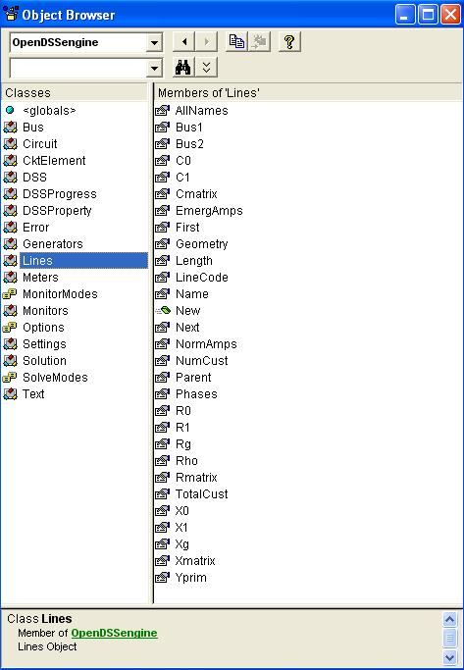
Lines Interface
This interface is provided to iterate through all the lines in the circuit and change the most common properties of Lines.

Slide 17
Example: Setting all LineCodes to a Value
Set DSSLines = DSSCircuit.Lines
. . .
iL = DSSLines.First ‘sets active
Do While iL>0
DSSLines.LineCode = MyNewLineCode
iL = DSSLines.Next ‘ get next line
Loop

Slide 18
VBA Example
Option Explicit
Public DSSobj As OpenDSSengine.DSS
Public DSSText As OpenDSSengine.Text
Public DSSCircuit As OpenDSSengine.Circuit
Public Sub StartDSS()
' Create a new instance of the DSS
Set DSSobj = New OpenDSSengine.DSS
' Assign a variable to the Text interface for easier access
Set DSSText = DSSobj.Text
' Start the DSS
If Not DSSobj.Start(0) Then MsgBox "DSS Failed to Start"
End Sub
Define some public variables that are used throughout the project
This routine instantiates the DSS and starts it. It is also a good idea at this time to assign the text interface variable.

Slide 19
VBA Example
Public Sub LoadCircuit(fname As String)
' Always a good idea to clear the DSS when loading a new circuit
DSSText.Command = "clear"
' Compile the script in the file listed under "fname" cell on the main form
DSSText.Command = "compile " + fname
' The Compile command sets the current directory the that of the file
' Thats where all the result files will end up.
' Assign a variable to the Circuit interface for easier access
Set DSSCircuit = DSSobj.ActiveCircuit
End Sub
This subroutine loads the circuit from the base script files using the Compile command through the Text interface. “fname” is a string contains the name of the master file.
There is an active circuit now, so assign the DSSCircuit variable.

Slide 20
VBA Example
Public Sub LoadSeqVoltages()
' This Sub loads the sequence voltages onto Sheet1 starting in Row 2
Dim DSSBus As OpenDSSengine.Bus
Dim iRow As Long, iCol As Long, i As Long, j As Long
Dim V As Variant
Dim WorkingSheet As Worksheet
Set WorkingSheet = Sheet1 'set to Sheet1 (target sheet)
iRow = 2
For i = 1 To DSSCircuit.NumBuses ' Cycle through all buses
Set DSSBus = DSSCircuit.Buses(i) ' Set ith bus active
' Bus name goes into Column 1
WorkingSheet.Cells(iRow, 1).Value = DSSCircuit.ActiveBus.Name
' Load sequence voltage magnitudes of active bus into variant array
V = DSSBus.SeqVoltages
' Put the variant array values into Cells
' Use Lbound and UBound because you don't know the actual range
iCol = 2
For j = LBound(V) To UBound(V)
WorkingSheet.Cells(iRow, iCol).Value = V(j)
iCol = iCol + 1
Next j
iRow = iRow + 1
Next i
End Sub
This Sub puts the sequence voltage onto a spreadsheet
Define a variable for the Bus interface
Define a variant to pick up the arrays
Cycle through all the buses
Get the bus name
Get the voltages into the variant array
Put them on the spreadsheet

Slide 21
Running OpenDSS From Matlab
Starting the DSS
%Start up the DSS
[DSSStartOK, DSSObj, DSSText] = DSSStartup;
function [Start,Obj,Text] = DSSStartup
% Function for starting up the DSS
%
%instantiate the DSS Object
Obj = actxserver('OpenDSSEngine.DSS');
%
%Start the DSS. Only needs to be executed the first time w/in a
%Matlab session
Start = Obj.Start(0);
% Define the text interface to return
Text = Obj.Text;

Slide 22
Using the DSS through the DSSText Interface from Matlab (harmonics example)
%Compile the DSS circuit script
DSSText.Command = 'compile master.dss';
% get an interface to the active circuit called "DSSCircuit"
DSSCircuit = DSSObj.ActiveCircuit;
%Determine which connection type for the source and call
%appropriate DSS file
switch XFMRType
case 1
DSSText.Command = 'redirect directconnectsource.DSS';
case 2
DSSText.Command = 'redirect deltadelta.DSS';
case 3
DSSText.Command = 'redirect deltawye.DSS';
otherwise
disp('Unknown source Connection Type')
end
%Set the system frequency and vsource frequency for harmonic requested
DSSText.Command = ['set frequency=(' num2str(Freq) ' 60 *)'];
DSSText.Command = ['vsource.source.frequency=(' num2str(Freq) ' 60 *)'];

Slide 23
Using the DSS through the DSSText Interface from Matlab (harmonics example) (cont’d)
% Vary the parameters according to a random distribution
% If more parameters need to be varied, just add them to the below
% list. Set ParamNum to total number of parameters varied
ParamNum = 6; %ParamNum used for sorting/plotting
for Case_Count = 1:Max_Cases
%Create index in the OutputData matrix to keep the cases in order
OutputData(Case_Count,1) = Case_Count;
% Generate random new coordinates for each conductor
[x1 y1 x2 y2 x3 y3 geomean] = RandomGeometry(8,0.75,30);
(... etc. etc. )
%define a new line geometry with random spacing
DSSText.Command = ['New LineGeometry.OHMOD nconds=3 nphases=3 cond=1 wire=acsr336 x=' num2str(x1) ' ' num2str(y1) ' units=ft cond=2 wire=acsr336 x=' num2str(x2) ' ' num2str(y2) ' units=ft cond=3 wire=acsr336 x=' num2str(x3) ' ' num2str(y3) ' units=ft'];
%Solve the circuit
DSSText.Command = 'solve';
(etc. etc.)

Slide 24
User-Written Controls
From the COM Interface

Slide 25
Basic Control Loop Flow Chart
You can single-step through this
If you set Number=1, you can break in here
Initialize Loop
Solve Circuit
Next Time Step
Check Controls
NO
Control Actions Done?
YES

Slide 26
Control Loop (Actual Pascal Code)
FUNCTION TSolutionObj.SolveSnap:Integer; // solve for now once
VAR
TotalIterations :Integer;
Begin
SnapShotInit;
TotalIterations := 0;
REPEAT
Inc(ControlIteration);
Result := SolveCircuit; // Do circuit solution w/o checking controls
{Now Check controls}
CheckControls;
{For reporting max iterations per control iteration}
If Iteration > MostIterationsDone THEN MostIterationsDone := Iteration;
TotalIterations := TotalIterations + Iteration;
UNTIL ControlActionsDone or (ControlIteration >= MaxControlIterations);
If Not ControlActionsDone and (ControlIteration >= MaxControlIterations) then Begin
DoSimpleMsg('Warning Max Control Iterations Exceeded. ' + CRLF + 'Tip: Show Eventlog to debug control settings.', 485);
SolutionAbort := TRUE; // this will stop this message in dynamic power flow modes
End;
If ActiveCircuit.LogEvents Then LogThisEvent('Solution Done');
Iteration := TotalIterations; { so that it reports a more interesting number }
End;

Slide 27
External Script and COM Interface Options
Take Immediate action or keep track of time yourself
  Set Number=1
  Sample after solution step
  Execute command to change element state
Use the DSS Control Queue through the COM Proxy
  Set Number=1
  Step through solution
  Push control commands onto DSS control queue
    (Allows DSS to keep track of when control actions happen)
  Write routines to handle pending actions

Slide 28
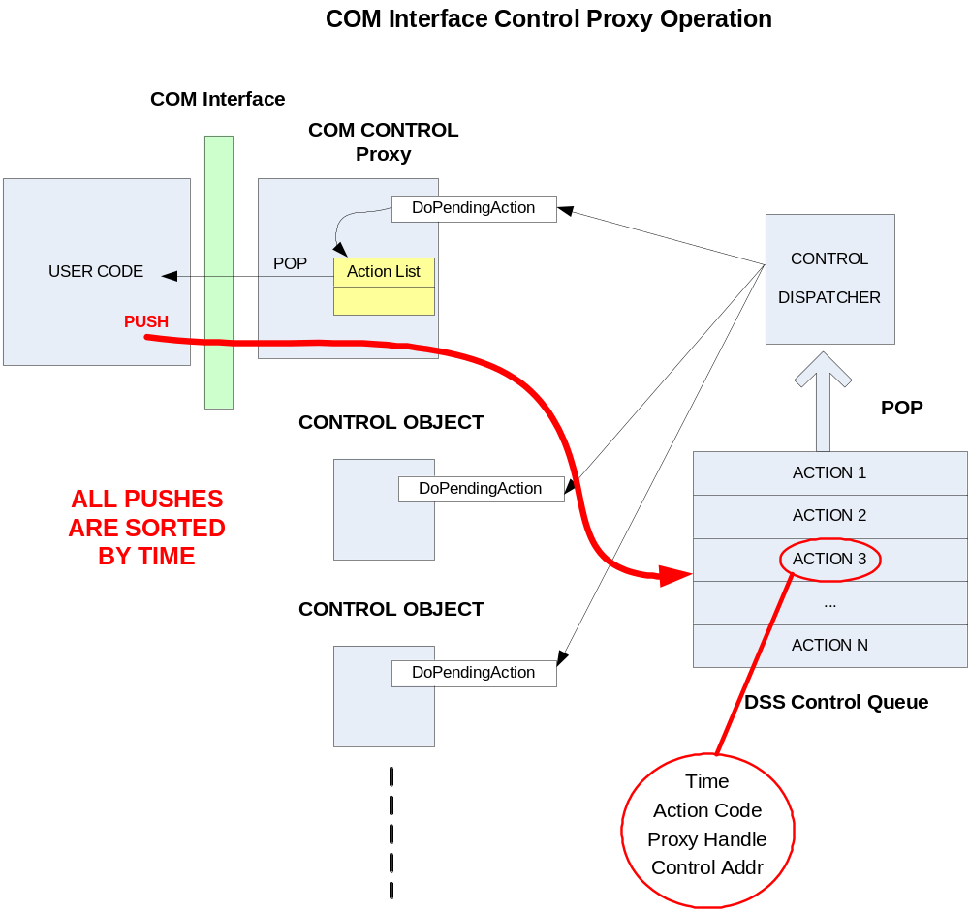
Control Proxy in COM Interface

Slide 29
Together…Shaping the Future of Electricity

